Slide 1
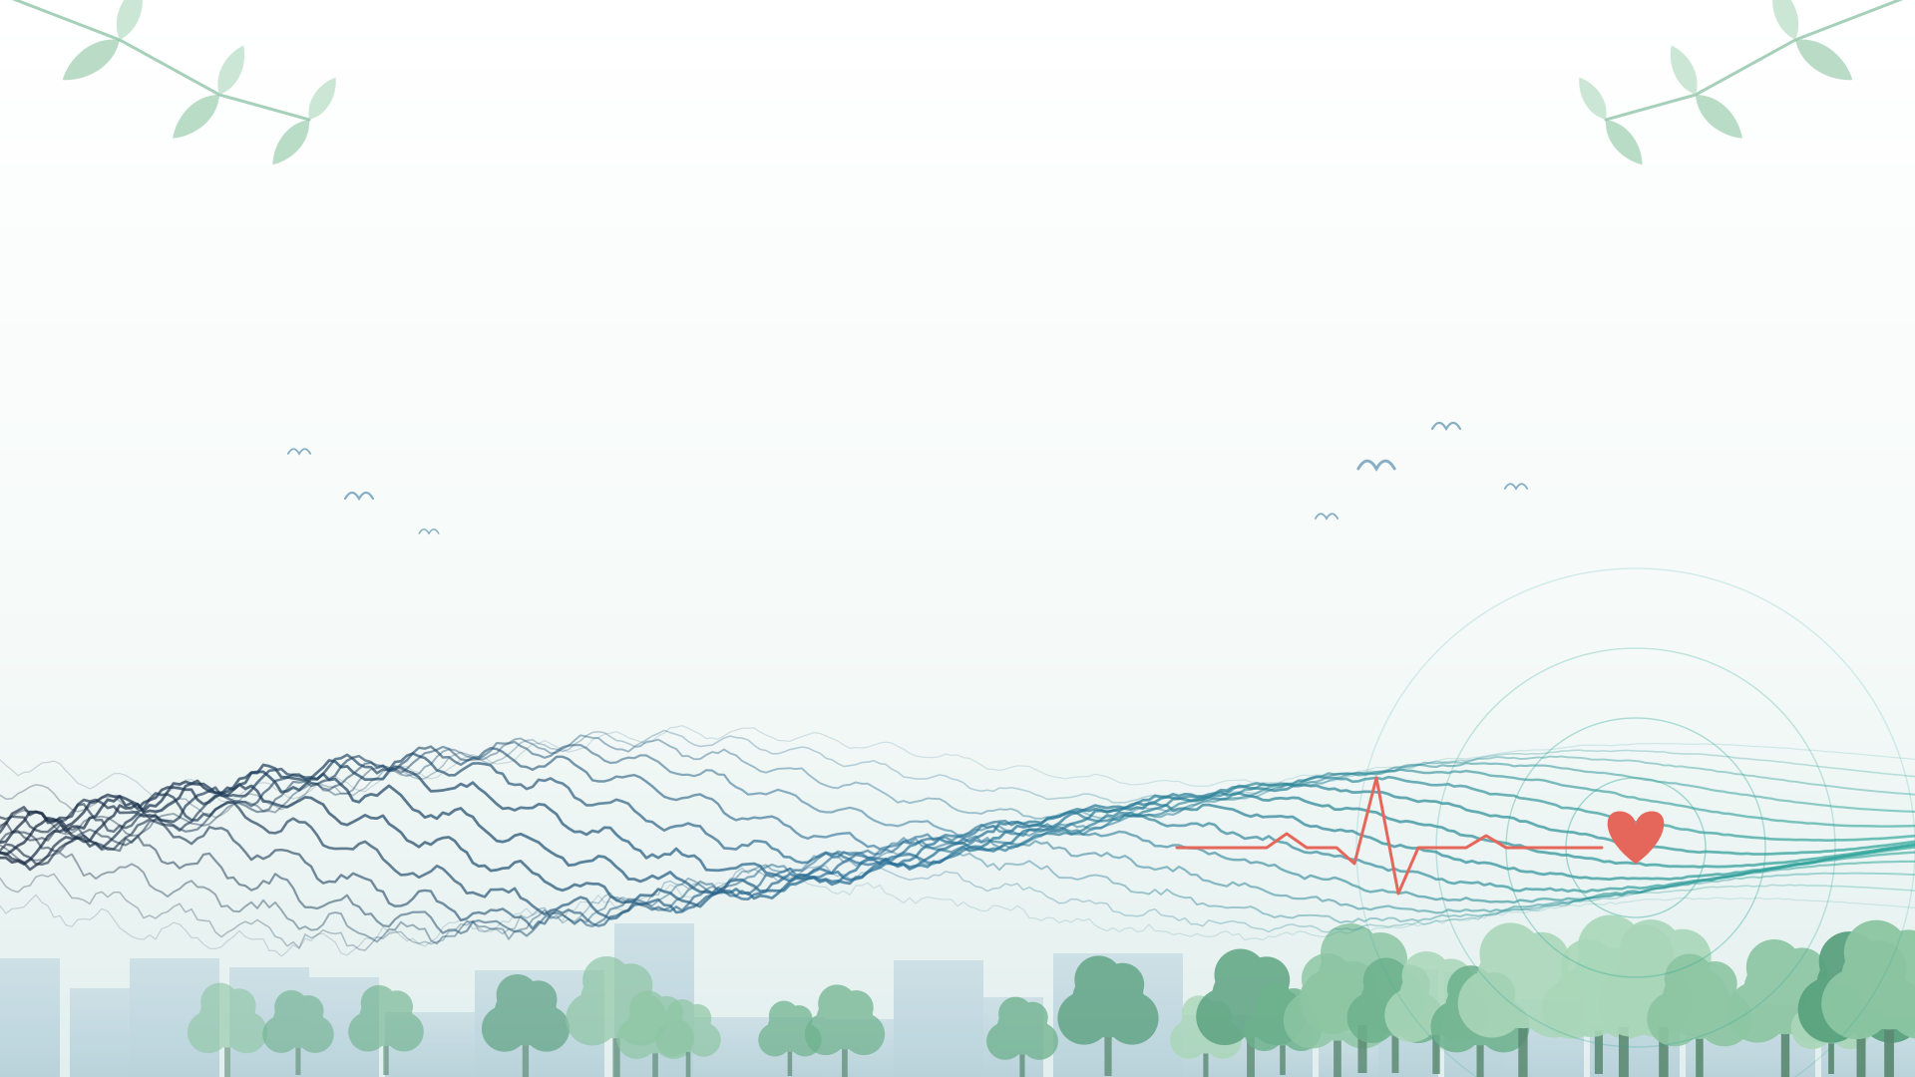



RESONATE
REcommending Evidence-based SOundscape interventioNs for noise-sensitive urbAn TErritories
An AI neighbourhood acoustic twin that tells cities what to change around schools, hospitals and care homes
Imperial College London · Politecnico di Milano · Technical University of Munich
Dipankar Bhattacharya · Simone Perottoni · Sandra Rojas-Botero
Notes:
~10 s. Introduce the three of us and the one-line idea: an acoustic twin that recommends what to build, plant or change.

Slide 2
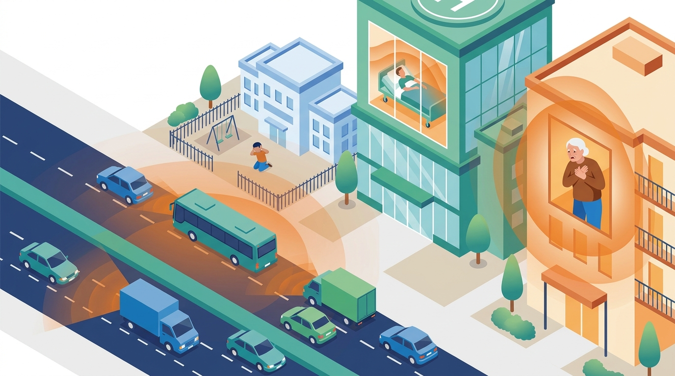
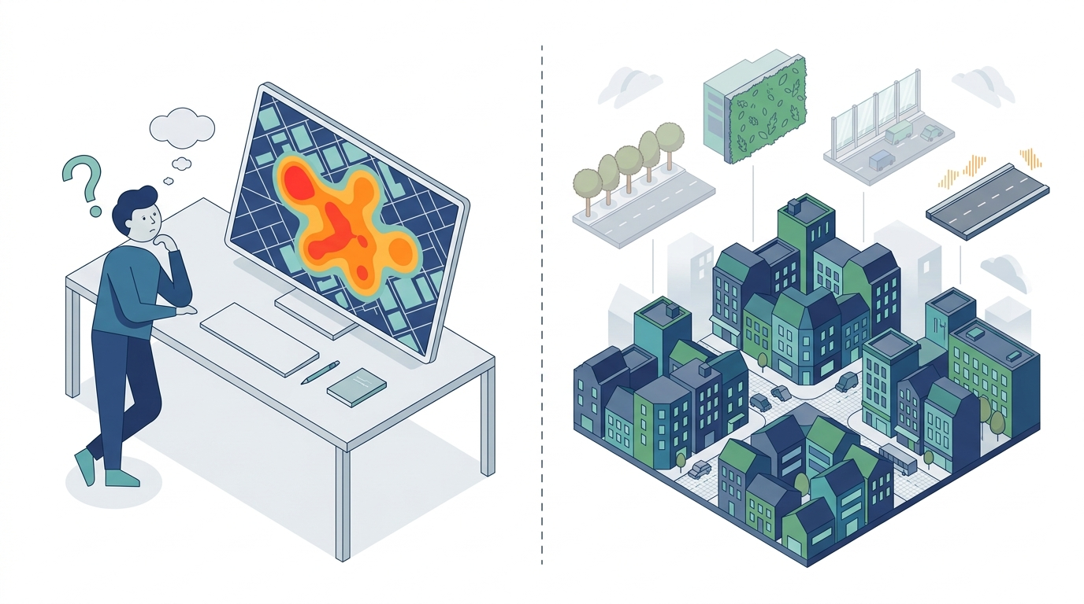
THE PROBLEM AND OUR RESEARCH QUESTION
Noise is mapped, but nobody is told what to do about it
Who suffers
Maps exist ...
... decisions don't
1 in 5
Europeans live with harmful road noise
#2
environmental health risk in Europe (EEA)
0
EU noise limit values or reduction targets
43
intervention studies report health outcomes: too few to learn from
?
Trees, green wall, low-noise surface or 20 mph: which, where?
The missing step: from “where is it loud?” to “what should we build, plant or change, and where?”
RESEARCH QUESTION
Can we build a predictive tool that tells cities which interventions will reduce noise and improve how people experience sound around schools, hospitals and care homes?
Develop and validate RESONATE, a transferable AI decision tool that turns neighbourhood sound and context into a ranked portfolio of interventions for noise-sensitive buildings.
AIM
So we model:
Noise sources
Perception
Neighbourhood features
RESONATE · Imperial College London · Politecnico di Milano · TU Munich
1
Notes:
~2 min. Problem: traffic noise reaches the people least able to escape it: pupils, patients, care-home residents. Noise is Europe's second environmental health risk, yet there are no EU limit values. Cities have maps and sensors, but going from 'here is the noise' to 'here is what to build, plant or change' is still expert guesswork; only 43 intervention studies report health outcomes. Our question, kept simple: can we build a tool that predicts which interventions will make these places quieter and better to be in? Aim: RESONATE. And what matters is not only decibels: parrots are loud but don't annoy, a horn does, so we model sources, perception and neighbourhood features.

Slide 3
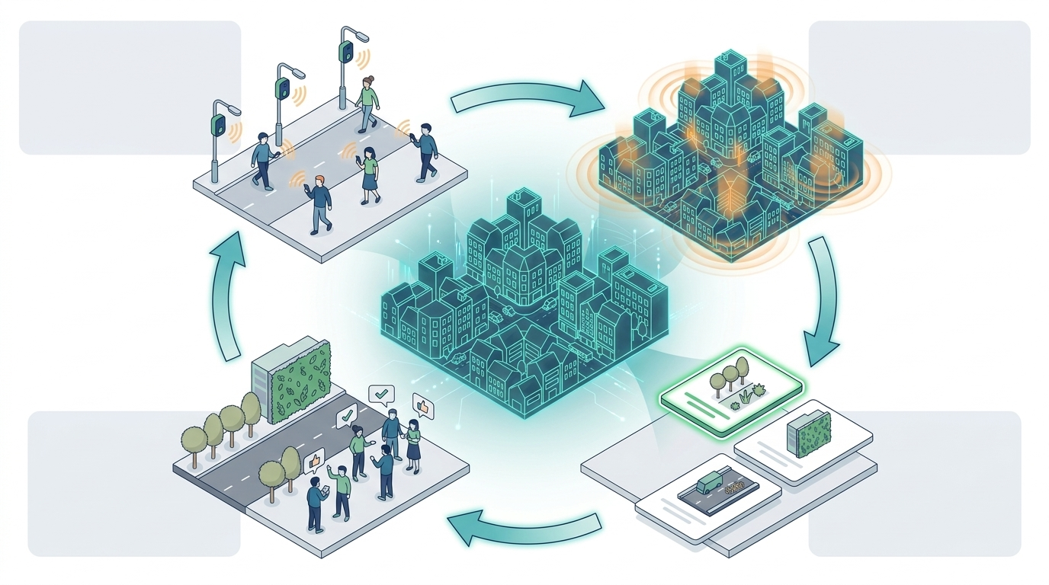
OBJECTIVES, HOW IT WORKS AND WHO WE ARE
An acoustic twin that prescribes interventions and learns from living labs
THE TEAM
1 OBSERVE
Sensors, soundwalks, street features
2 TWIN
Measured + perceived sound
Dipankar Bhattacharya Imperial College London
AI and autonomous systems
Simone Perottoni Politecnico di Milano
Biomedical engineering, physical prediction models, hearing loss and dementia
Sandra Rojas-Botero TU Munich
Nature-based solutions, urban ecology, field monitoring and experiments
4 LIVING LAB
Co-implement in 3 cities
3 PRESCRIBE
AI ranks the options
EXPERTISE WE STILL NEED
Acoustics & soundscape monitoring: e.g. TU Berlin Technical Acoustics (Prof. Sarradj), TUM CitySoundscapes
Public & mental health: perception, masking, health outcomes
Potential partners, not yet approached
THREE OBJECTIVES
1
OBSERVE Gather the information
2
3
STAKEHOLDERS
TWIN Build the twin
PRESCRIBE Use it to decide
Living-lab monitoring of sound levels and sources, street typology, morphology and vegetation, and residents' perception.
A physics-based neighbourhood twin, calibrated; predicts what is measured (dB) and what is felt (annoyance, masking).
A ranked, costed portfolio per site (trees, green walls, low-noise surface, speed, barriers) with predicted gain and confidence; tested in living labs.
Decide
Councils, hospital & school estates
Live with it
Pupils, patients, care-home residents
Build it
Consultants, planning & transport authorities
RESONATE · Imperial College London · Politecnico di Milano · TU Munich
2
Notes:
~2.5 min. Three objectives, one per layer, walked round the loop. 1 Observe: gather the information, meaning sound data plus the full description of the neighbourhood (typology, morphology, vegetation) and how people perceive it. 2 Twin: the physics-based neighbourhood twin, calibrated on those data, which predicts measured and perceived sound and generates the what-if scenarios the AI learns from. 3 Prescribe: the AI ranks a costed portfolio, which we co-implement and test in living labs in London, Munich and Milan and feed back. Team: AI (Imperial), physical and health models (PoliMi), nature-based solutions and field work (TUM). Still missing: acoustics/soundscape monitoring and public health. Stakeholders in three groups.

Slide 4
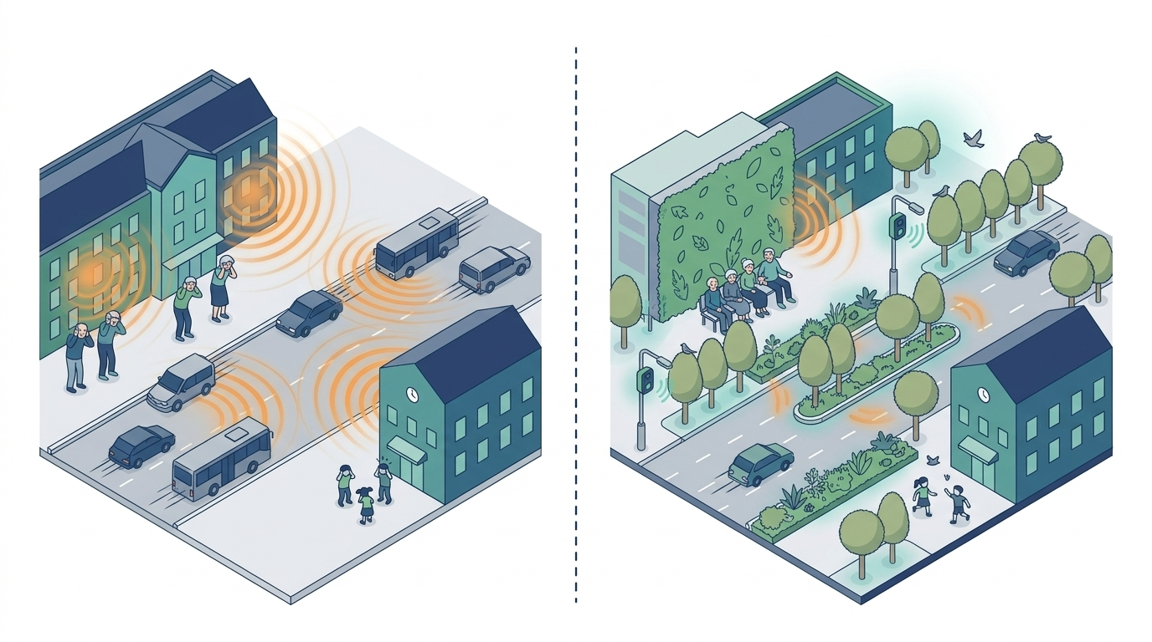
PROGRESS, PLAN AND DELIVERABLES
Where we are, the year ahead, and what we will deliver
PROGRESS SO FAR
PLAN FOR THE YEAR
✓ Core team formed: Imperial · PoliMi · TUM
✓ London working sessions: framework agreed (twin + intervention portfolio + living labs)
✓ Concept proposal and literature screening: no existing tool goes from noise map to decision
✓ Connect Fund bid drafted: £6,000, January 2027 panel
✓ Living-lab cities shortlisted (London, Munich, Milan); potential collaborators identified, to be approached
Oct–Dec 2026
Jan–Mar 2027
Apr–Jun 2027
Jul–Sep 2027
Oct 2027 →
Visit TUM (ETA)
Approach acoustics / health collaborators
Submit Connect Fund
Connect Fund award
Acoustics course (Simone)
2-day workshop at Imperial
Visit potential collaborators
Review paper with preliminary twin results
Pilot monitoring
Submit to the screened funding call
Throughout: screening Horizon Europe and other calls to target
DELIVERABLES
Workshop
2-day Connect Fund workshop at Imperial with partners and invited experts
Co-supervised Master's theses
Joint student projects across Imperial, PoliMi and TUM
Preliminary model
First neighbourhood twin and recommender prototype on one pilot site
Before
After: living lab
Review paper
'From noise maps to decisions', with the preliminary model results
RESONATE consortium
Core team plus acoustics and health partners and living-lab cities
Funding calls
Connect Fund (£6,000) → Horizon Europe bid; other funds being screened
RESONATE · Imperial College London · Politecnico di Milano · TU Munich
3
Notes:
~2 min. Progress: team, framework agreed in London, concept and literature screening, Connect Fund drafted. Year plan: visit TUM and submit Connect Fund, acoustics course, workshop and visits, review paper with preliminary results, then the screened funding call. Close: 'We want to turn noise maps into decisions, starting with the buildings where it matters most.'

